Slide 1







AI & Its Power Subfields
Sean Wong
2025/08/01

Slide 2




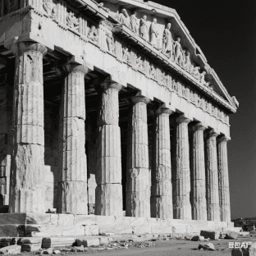



CONTENTS
01
AI Foundations
02
Machine Learning Core
Topics
03
Deep Learning Inside
04
Generative AI Wave
05
Agentic AI Frontier

Slide 3










CONTENTS
01
Ethics and Next Steps
02
Synthesis & Action

Slide 4


01
AI Foundations

Slide 5





What Artificial Intelligence Really Is
AI Definition
Types of AI
Daily AI Interaction
Artificial Intelligence (AI) is the science of creating machines that can perform tasks requiring human intelligence, such as reasoning, language understanding, vision, and decision-making.
Narrow AI handles specific tasks like virtual assistants and recommendation systems. General AI can perform any intellectual task a human can, while Superintelligent AI surpasses human capabilities.
Reflect on where you encounter AI daily, such as smart home devices, social media algorithms, and voice assistants. Consider how AI differs from traditional rule-based software.

Slide 6






AI Landscape and Everyday Impact
Narrow AI Examples
Virtual assistants like Alexa and Siri, recommendation systems on Netflix and Amazon, and smart cameras are all examples of Narrow AI. These systems perform specific tasks efficiently.
AI vs. Traditional Software
Traditional software follows predefined rules, while AI learns and adapts. AI systems can improve over time with more data, unlike static rule-based programs.

Slide 7
02
Machine Learning Core

Slide 8




Machine Learning Essence
ML Definition
Unsupervised Learning
Machine Learning (ML) is a subset of AI that enables computers to learn patterns from data and make predictions or decisions without explicit programming.
Unsupervised learning finds patterns in unlabeled data, such as segmenting customers based on purchasing behavior without predefined categories.
Details
Supervised Learning
Reinforcement Learning
In supervised learning, models learn from labeled data to predict outcomes. For example, predicting house prices based on historical data.
Reinforcement learning involves trial and error with rewards. AI agents learn optimal actions to achieve goals, like game-playing AI.

Slide 9




ML Workflow and Business Wins
Content
ML Workflow and Business Impact
The ML workflow includes data collection, feature engineering, model training, validation, and deployment. It drives business benefits like sales forecasting, fraud detection, and personalized recommendations.

Slide 10
03
Deep Learning Inside

Slide 11



Deep Learning Mechanisms
Insights
01
DL Definition
Deep Learning (DL) is a subset of ML that uses multi-layer neural networks to learn complex patterns from large datasets. It powers advanced applications like image and language processing.
02
Key Architectures
DL architectures include CNNs for image recognition, RNNs/LSTMs for sequential data, and Transformers for natural language processing. Each is tailored to specific tasks.
02

Slide 12




From Theory to Real DL Products
DL Applications
DL powers face recognition in social media, machine translation, voice assistants, and autonomous vehicles. It requires large datasets and significant computational resources.
Matching Exercise
Match network types with applications: CNNs for image classification, RNNs for time-series forecasting, and Transformers for language models. This reinforces understanding.
Practical Impact
DL models transform industries by automating complex tasks and providing insights from vast amounts of data, driving innovation and efficiency.

Slide 13
04
Generative AI Wave

Slide 14




Generative AI Creation Power
Impact
GenAI Definition
Applications
Generative AI revolutionizes content creation by enabling rapid production of high-quality outputs, democratizing creativity and enhancing productivity.
Generative AI creates new content like text, images, music, and video by learning patterns from existing data. It uses models like Transformers and GANs.
GenAI powers ChatGPT for text generation, DALL-E for images, AIVA for music, and Runway for video. These tools can produce creative and coherent outputs.

Slide 15



Hands-On GenAI Exploration
01
Experiment with GenAI tools like ChatGPT or DALL-E. Input prompts and observe how the model generates coherent and creative outputs.
Experimentation
02
Through hands-on experience, understand how prompts influence results, refine outputs, and explore the potential of generative models.
Learning Through Practice

Slide 16
05
Agentic AI Frontier

Slide 17






Agentic AI Autonomy Defined
Agentic AI Definition
Applications
Agentic AI refers to systems that can make autonomous decisions and achieve goals in dynamic environments without continuous human intervention.
Examples include autonomous drones, robotic assistants, and self-driving cars. These systems operate autonomously to complete complex tasks.
Characteristics
Reflection
These systems are goal-oriented, adaptive, and capable of real-time learning. They can plan and execute tasks independently.
Consider the potential benefits of Agentic AI, such as increased efficiency and productivity, and the risks of unpredictable behavior.

Slide 18



Simulation and Safe Deployment
Simulation Platforms
Part
Simulation platforms like AutoGPT and BabyAGI allow testing of Agentic AI in controlled environments. Implement safety measures to ensure reliable deployment.

Slide 19
06
Ethics and Next Steps

Slide 20









Ethical Challenges Across AI
Bias and Fairness
AI models can amplify biases in training data, leading to unfair outcomes. Mitigate this by using balanced datasets and fairness metrics.
Privacy
Protect personal data used for training AI models. Implement robust data anonymization and security measures.
Autonomy and Control
Agentic AI can act unpredictably. Ensure oversight and control mechanisms to manage autonomous systems safely.

Slide 21




Governance and Responsible Innovation
Regulations and Standards
Interdisciplinary Collaboration
Adhere to emerging regulations and industry standards for AI. Promote transparency and accountability in AI development.
Form interdisciplinary teams to address ethical challenges. Continuously monitor AI systems to ensure they align with ethical principles.

Slide 22
07
Synthesis & Action

Slide 23



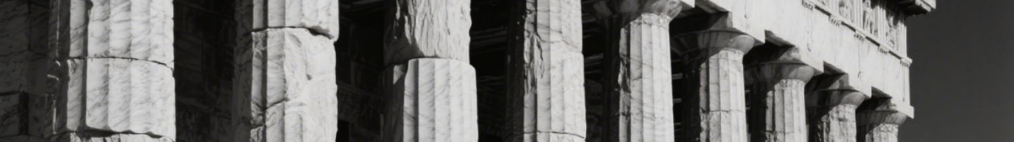

Subfield Map and Career Trajectories
Details
AI Subfield Hierarchy
Tools
Career Paths
Continuous Learning
AI encompasses ML, which includes DL. GenAI leverages DL, while Agentic AI focuses on autonomy. Each subfield has distinct tools and applications.
Familiarize yourself with tools like TensorFlow, PyTorch, OpenAI, and AutoGPT. These tools are essential for developing and deploying AI solutions.
Explore career opportunities in data science, model development, creative design, and autonomous systems. Each path offers unique challenges and rewards.
Stay updated with the latest advancements in AI. Continuous learning is crucial for adapting to the rapidly evolving landscape of AI technologies.

Slide 24


Takeaways and Immediate Experiments
Actionable Steps
Recap AI subfields, applications, and ethical considerations. Experiment with training a classifier, generating content with GenAI, and simulating an agent. Share your results and iterate.

Slide 25

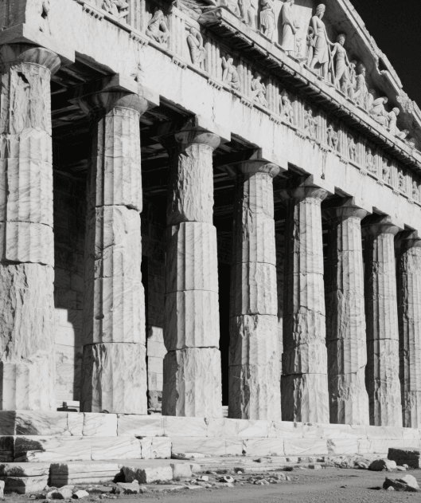
THANK YOU
Sean Wong
2025/08/01

